Slide 1
Digital Portfolio
STUDENT NAME: LALITHAMBIKA N M
REGISTER NO: 2426J0486
NMID: 804EB100E223636A63E42A1085B7AB67
DEPARTMENT: Information Technology
COLLEGE: Sri Krishna Adithya College of Arts and Science /
Bharathiyar University

Slide 2
PROJECT TITLE
Restaurant Menu Page portfolio using Frontend Web Development

Slide 3

AGENDA
Problem Statement
Project Overview
End Users
Tools and Technologies
Portfolio design and Layout
Features and Functionality
Results and Screenshots
Conclusion
Github Link

Slide 4

PROBLEM STATEMENT
Most student portfolio websites are limited to presenting personal details, academic achievements, and project work in a static format, which fails to fully engage viewers or demonstrate practical technical skills.
There is a lack of interactivity and creative features that can make a portfolio stand out.
In today’s digital-first world, restaurants need an engaging and user-friendly online presence to showcase their food and attract customers. Many small restaurants lack a simple, interactive, and visually appealing online menu that customers can browse before visiting or ordering. The goal of this project is to design and develop a responsive Restaurant Menu Page using fundamental front-end web development technologies (HTML, CSS, and JavaScript).

Slide 5
PROJECT OVERVIEW
The Restaurant Menu Page is a front-end web development project built using HTML, CSS, and JavaScript.
It displays food categories such as Starters, Main Course, Desserts, and Drinks, with each item showing an image, description, and price.
The page includes search and filter options for easy navigation and is fully responsive, ensuring a smooth experience on desktop and mobile devices.
This project highlights my skills in structuring content, styling layouts, and adding interactivity using fundamental web technologies.

Slide 6

WHO ARE THE END USERS?
Students (Portfolio Owners) – create and manage their portfolio and restaurant menu page.
Recruiters / Employers – view student’s skills, projects, and assess
technical abilities.
Teachers / Mentors – evaluate the portfolio as part of academic
assessment.
Peers / Classmates – explore the portfolio and engage with restaurant menu page.
General Audience / Visitors – browse the website for both portfolio
and restaurant menu page content.

Slide 7
TOOLS AND TECHNIQUES
HTML5 → for structuring the content and creating menu sections. CSS3 → for styling, layout design, responsiveness, and hover effects. JavaScript (ES6) → for interactivity such as search and category filtering.
Responsive Web Design → using CSS Grid, Flexbox, and media queries for mobile-friendly layout.
Navigation and Linking → smooth category navigation with internal links.
DOM Manipulation → dynamically showing/hiding menu items with JavaScript.

Slide 8
POTFOLIO DESIGN AND LAYOUT
Homepage – Student’s name, photo, tagline, and
navigation bar.
About Me – Profile picture with short bio, education, and goals.
Skills Section – Skills shown using progress bars, icons, or charts.
Projects Section – Grid/cards with project title,
description, tech stack, and links.

Slide 9
Restaurant Menu Page –The Restaurant Menu Page is designed with a clean, responsive, and user-friendly layout to highlight food items effectively. The design uses a card-based structure with images, descriptions, and prices for each dish.
Contact Section – Contact form, social media links, and footer.
Design Principles – Responsive layout, consistentcolors, clear fonts, proper spacing, and smooth animations.

Slide 10
FEATURES AND FUNCTIONALITY
Responsive Design – Works smoothly on desktop, tablet, and mobile devices. Category Sections – Menu divided into Starters, Main Course, Desserts, Drinks. Card-Based Layout – Each dish displayed with image, name, description, and price
Dynamic Search – JavaScript filters items instantly as users type in the search bar.
Category Filtering – Menu items are shown/hidden dynamically when selecting categories.

Slide 11
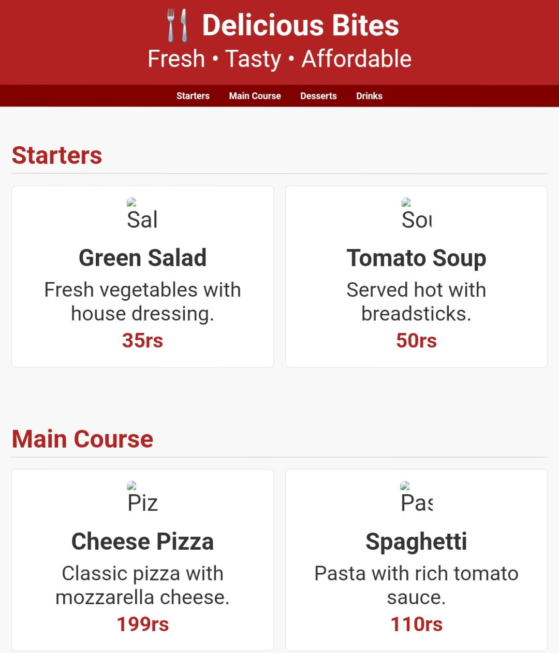
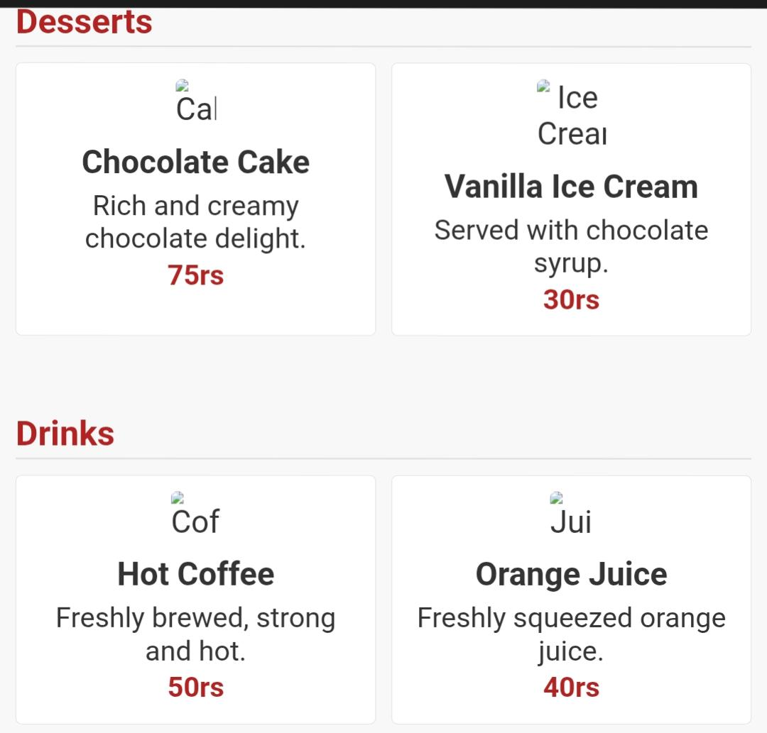
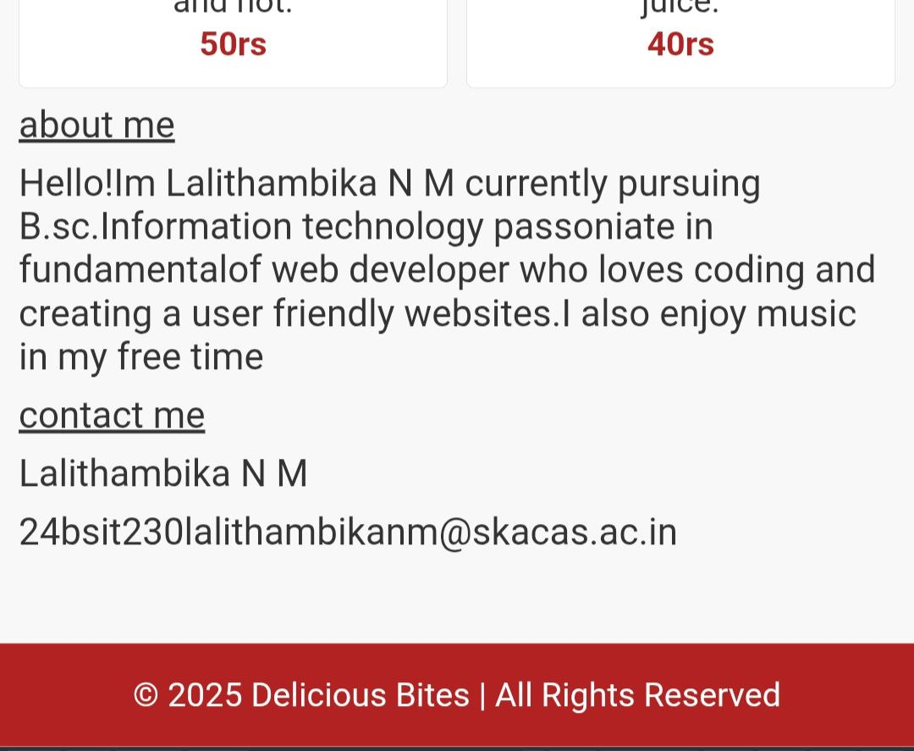
RESULTS AND SCREENSHOTS
Homepage with profile picture
11

Slide 12
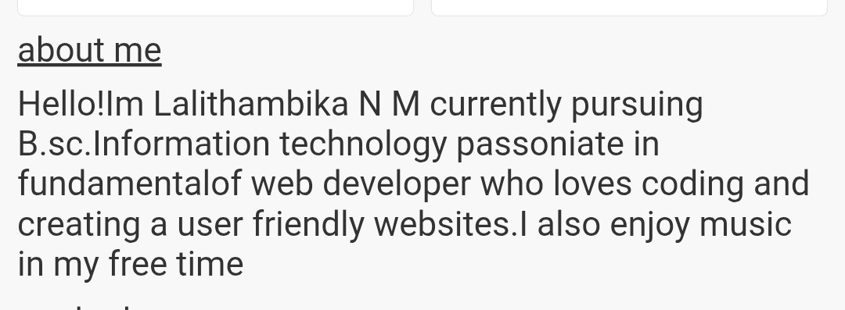
About Section

Slide 13
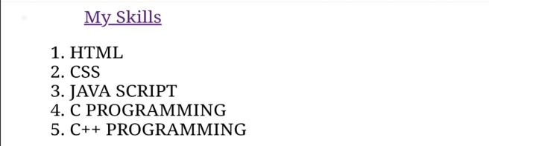
Skills Section

Slide 14
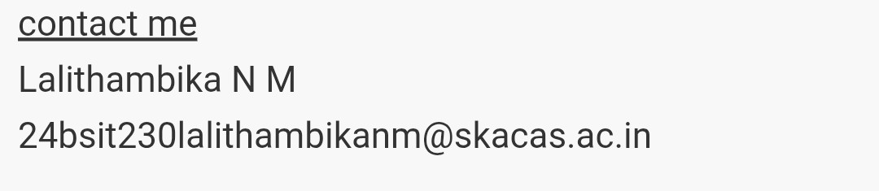
Contact Form

Slide 15
CONCLUSION
The Restaurant Menu Page project successfully demonstrates the use of fundamental front-end web development technologies (HTML, CSS, and JavaScript) to build a responsive, interactive, and user-friendly website. The design highlights restaurant branding while presenting menu items in an appealing, card-based layout. With features like category navigation, search, filtering, and responsive design, the project provides a smooth browsing experience across devices. This project not only replicates a real-world restaurant website but also showcases my ability to structure content, style layouts, and implement interactivity using core web technologies.
15

Slide 16
Github Link
https://github.com/24bsit230lalithambikanm-ui/TNSDC-FWD-DIGITAL-PORTFOLIO.git

